Slide 1
SOIL HUMIDITY MAINTAINOR
1. 207 VARUN AGARWAL
2. 210 DEEP PATEL
3. 211 MALAY PATIL

Slide 2
Problem Statement
To develop a system to count the humidity level and water the crop with the help of moisture sensor with the desired range.

Slide 3
Introduction
The primary objective of Soil Humidity Maintainer is to help the farmers to reduce their manual work by transforming this whole process into automated one. Watering the crops by manually checking the water level everyday of different crops and giving water to the crops accordingly is a cumbersome process . Many farmers are doing suicide just because of irregular crops ,many of them do not know what crop requires what amount of water leading irregularity in their crops like many a time cases occurs when farmers mistakenly gives crop with high drought tolerance lot of water and they give less amount of water to the crop with less drought tolerance and causing a huge loss of not only money but most of the times their land as well . So if we develop such a solution so as to reduce their work and also tell them about different water requirements for different crops by checking humidity level of the soil, there comes out to be three different states that is high , medium and low required for crops with low drought tolerance , medium drought tolerance and high drought tolerance.

Slide 4
Objective
The objective of the project is to provide a platform for farmers so that farmers can easily water their plants through their cellphones with the desired range .

Slide 5
LITERATURE SURVEY
Do you face any problem while watering the crops? YES/NO
Does amount of water in the crops plays a vital role? YES/NO
Do you want the method to be automatic ? YES/NO
Different crops require different amount of water? YES/NO
What if we we build the app for you so that some of your gets reduced? RELIEF/NOT NEEDED
What do you want in the app from our side?

Slide 6
Similar Projects
Automated Irrigation and crop in Agriculture using IOT
First of all farmers want a user friendly interface that will be provided by app rather than a website.
Secondly they are not providing farmers with types of crops and also.

Slide 7
Technology Stack
Hardware Requirements
Moisture Sensor
Arduino Nano
Motor
Battery
Jumper Wires
Relay Module
Software Requirements
Arduino IDE

Slide 8
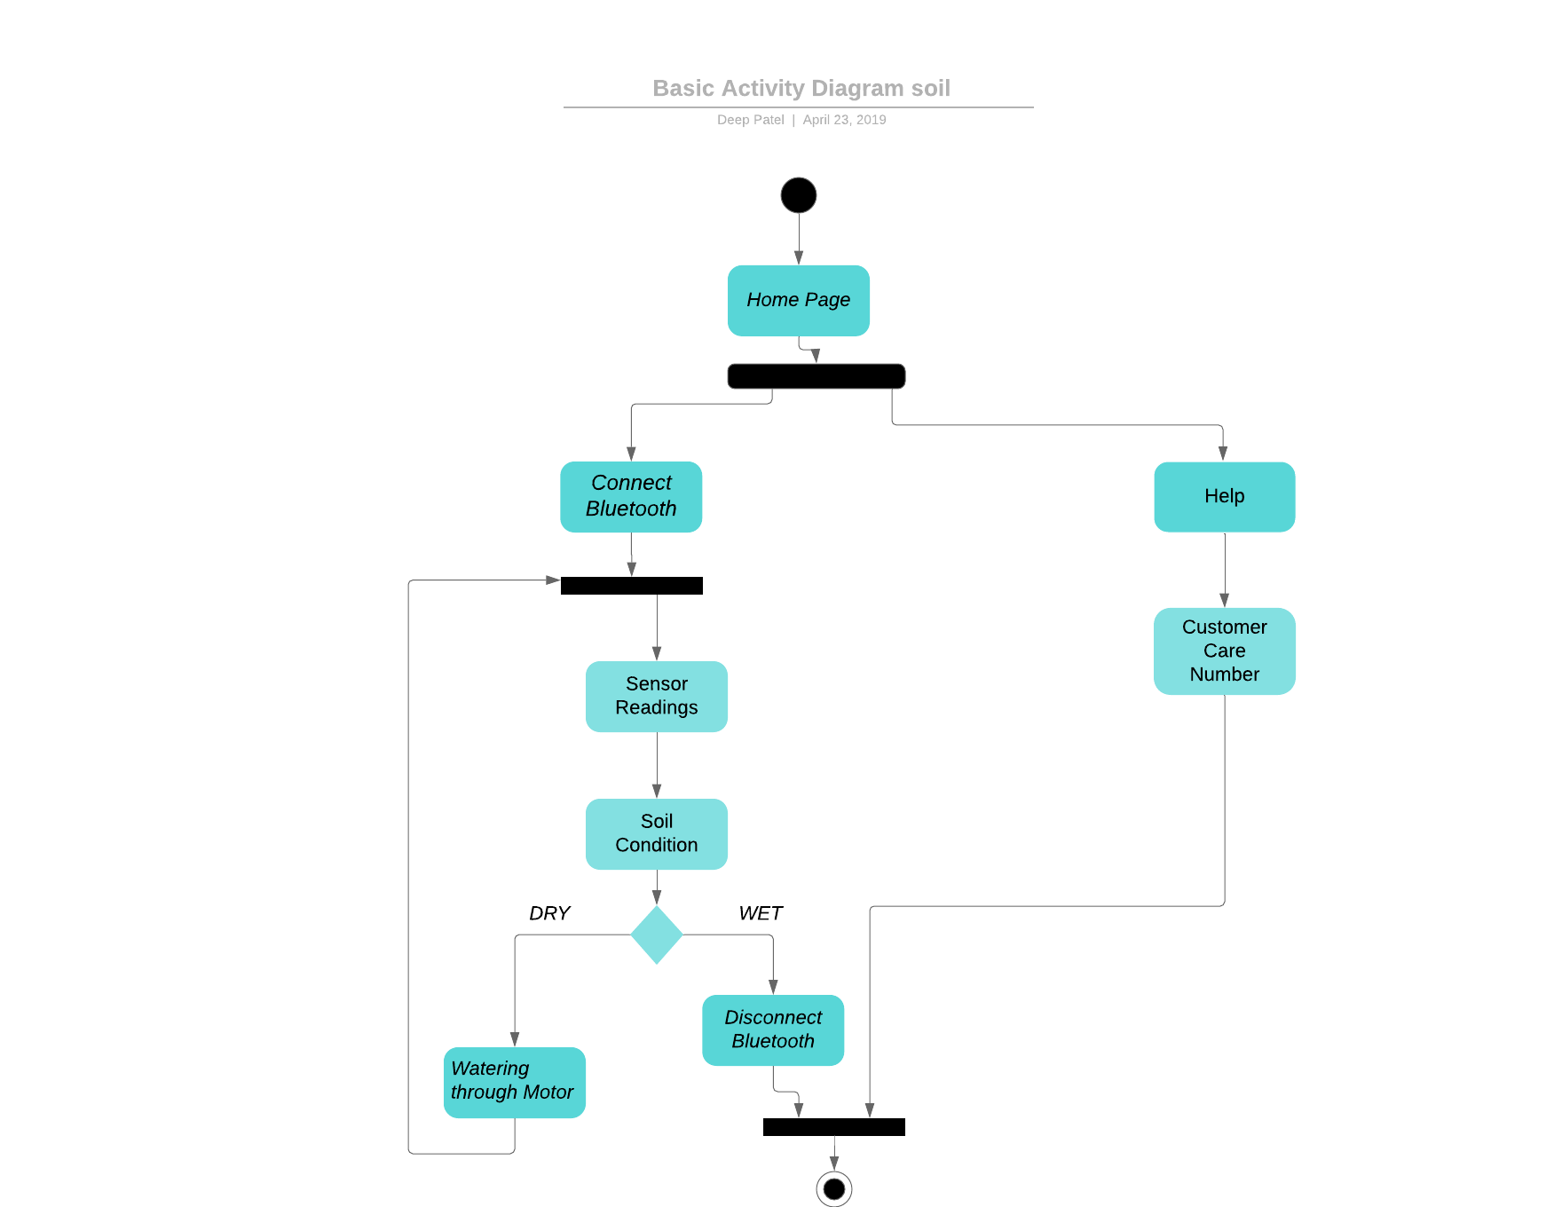
Activity Diagram

Slide 9
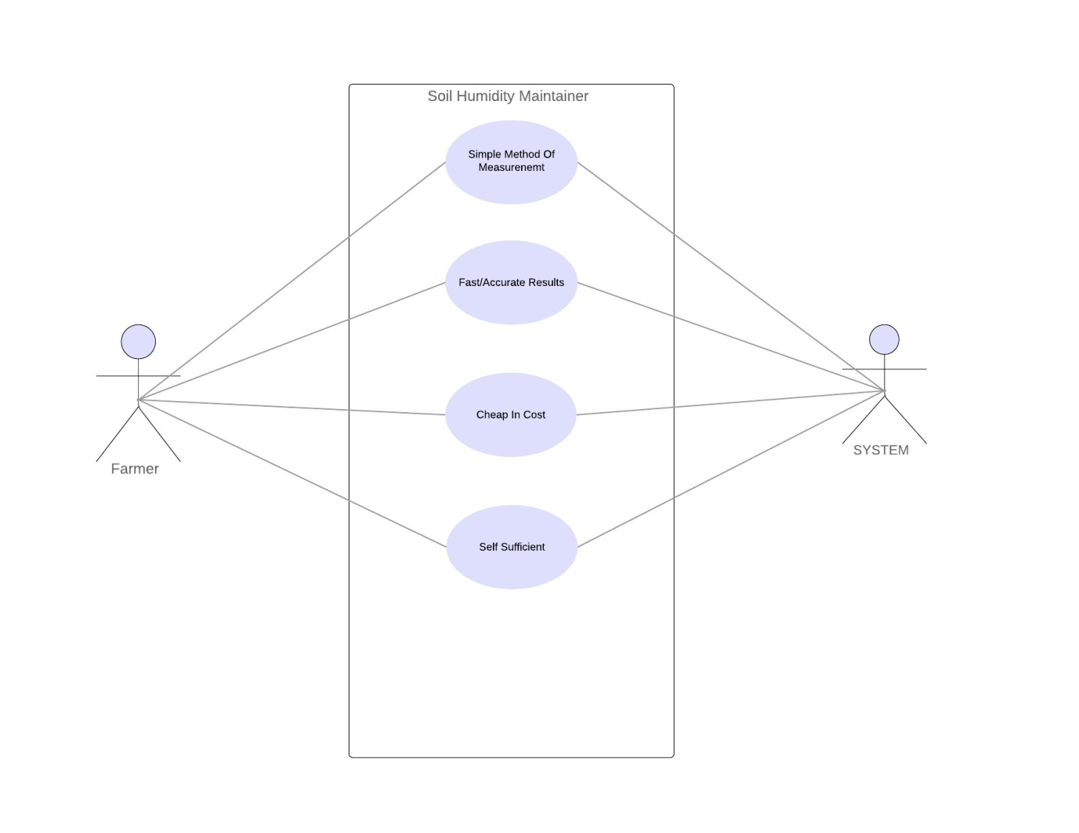
Use Case Diagram

Slide 10
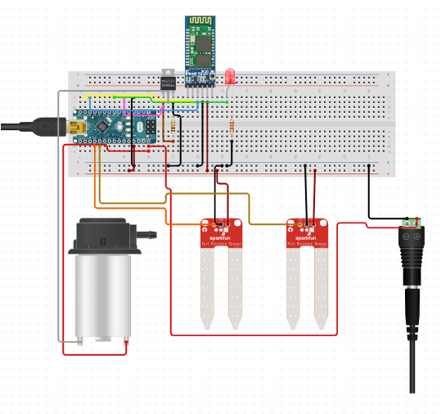
Circuit Diagram

Slide 11
Conclusion
We can conclude that, The sensitivity of moisture sensor is very high so it can give the exact condition and the humidity level of the soil . Farmers can easily water their plants by just operating through their cellphones.As per the crop's tolerance , Farmers can water their crops as per the requirement of the crop for the better furtility. For farmers' better use different languages are also been added .
As a crops is a basic need of human kind , if we implement technology to the agricultural it will be useful for people and farmers .Farmer can easily operate the watering of the crops. The technology can reduce the manual work for the farmers and also help them grow the crops through the function's description about the tolerance

Slide 12
Future Scope
It has a very promising future and since the implementation of this moisture sensor is too easy it can be used in many purposes with the different function.there’s no doubt this technology is gonna flourish in sectors mostly in agriculture or gardening .

Slide 13
Questions??

Slide 14
Thank you

